Slide 1
SiN MEETING REPORT
NEW FOCUS TUNABLE LASER FOR TRANSMISSION SPECTRum
ULTRAFAST OPTICS AND OPTICAL FIBER COMMUNICATIONS LABORATORY
Jose A. Jaramillo
ECE PhD Student

Slide 2
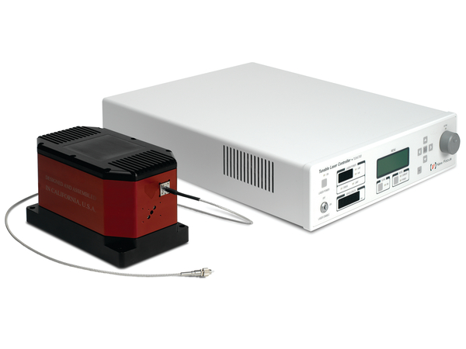
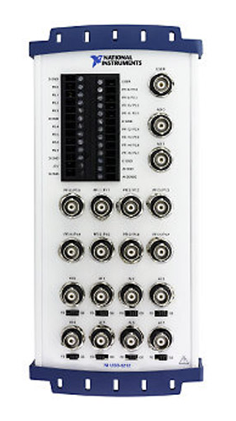
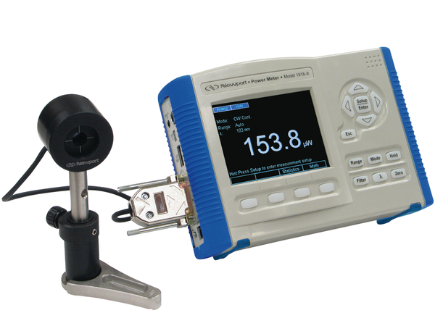
SETUP
Wavelength
Input
Frequency
Modulation Input
Wavelength
Output
Power Meter
Output
AO 0
AO 1
AI 0
AI 1
P1.0
P1.1
ULTRAFAST OPTICS AND OPTICAL FIBER COMMUNICATIONS LABORATORY

Slide 3
results
Wavelength
Input
ULTRAFAST OPTICS AND OPTICAL FIBER COMMUNICATIONS LABORATORY

